Slide 1






Presentation
INTER IIT TECH MEET 13.0 SELECTION HACKATHON
By Team Atreides
(Mohammed Arsh Raza)

Slide 2
INTRODUCTION
Problem
Dataset
Approach

Slide 3
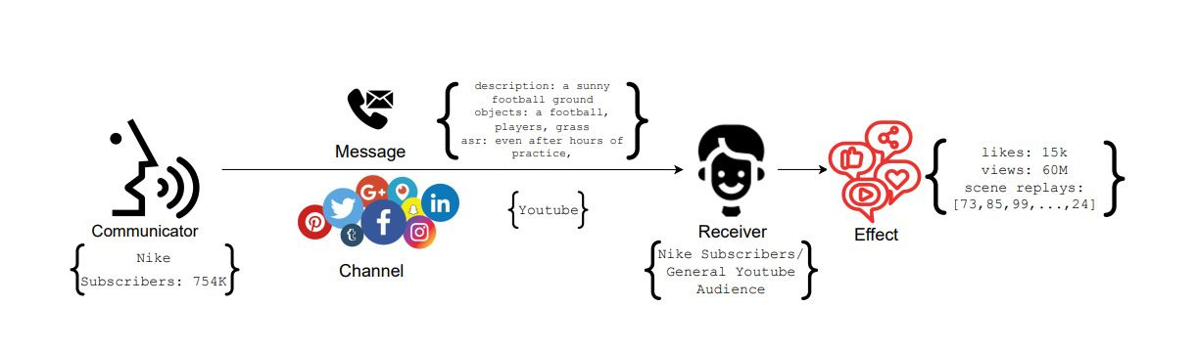
PROBLEM DECRIPTION
The process of communication is defined by marketing researchers as below: A receiver, upon receiving a message from a sender over a channel, interacts with the message, thereby generating effects (user behavior). Any message is created to serve an end goal. For a marketer, the eventual goal is to get the desired effect (user behavior) i.e. such as likes, comments, shares and purchases, etc.

Slide 4
PROBLEM
In this challenge, we will try to solve the problem of behavior simulation (Task-1) and content simulation (Task-2), thereby helping marketers to estimate user engagement on their social media content as well as create content that elicits the desired key performance indicators (KPI) from the audience.

Slide 5
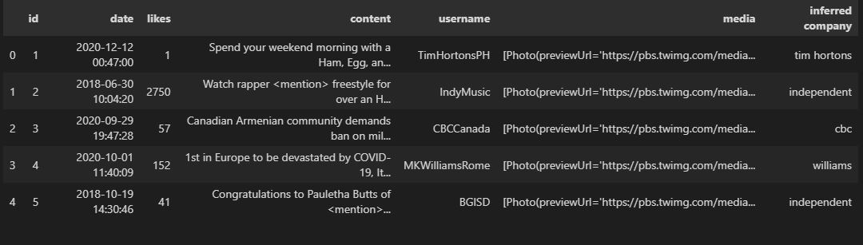
DATASET
Brands use Twitter to post marketing content about their products to serve several purposes, including ongoing product campaigns, sales, offers, discounts, brand building, community engagement, etc. User engagement on Twitter is quantified by metrics like user likes, retweets, comments, mentions, follows, clicks on embedded media and links. For this challenge, we have sampled tweets posted in the last five years from Twitter enterprise accounts. Each sample contains tweet ID, company name, username, timestamp, tweet text, media links and user likes.

Slide 6
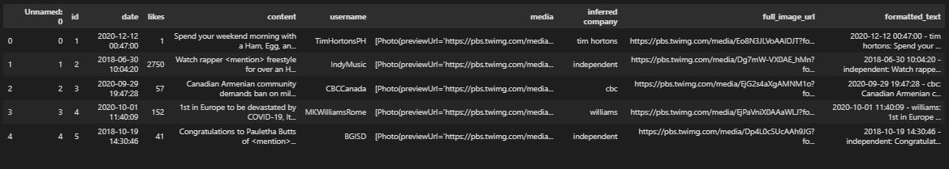
The content field alone is not sufficient to grasp the user behaviour so we create a new field comprised of date,content and infered company called formatted_text. The full image URLs has also been extracted in a new field to make it easier accessing the images.

Slide 7
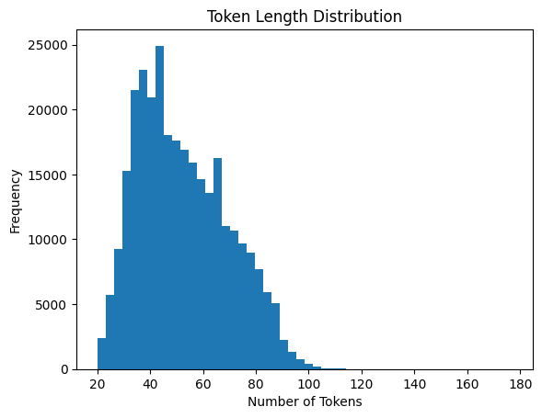
DATASET VISUALISTAION
The formatted_text field will be tokenized to be later used by the model, we need to understand the token length distribution so that we can create a uniform token length for the model to use.

Slide 8
SOLUTION
Task-1: Behavior Simulation
Approach 1️⃣
Here we employ the use of DistilBERT a smaller and faster version of BERT. We load a pre-trained model from the transfromers library.
The model outputs the hidden states, from which we select the embedding corresponding to the [CLS] token (first token).
After obtaining embeddings from BERT, a small feedforward neural network (fully connected layers) is used to predict the number of likes.
A Linear layer that transforms the hidden states (DistilBERT output) to a size of 180. The role of this layer is to reduce the dimensionality of the BERT embedding while retaining useful information. Here 180 corresponds to the maximum token length (177) in the given dataset.

Slide 9

DistilBERT hidden state → 768 dimensions (CLS token)
First Linear Layer → 180 dimensions
ReLU Activation → Adds non-linearity
Second Linear Layer → 1 dimension (predicted likes)
The loss function used is Mean Squared Error (MSE) because it's a regression task

Slide 10
APPROACH 2️⃣
In the previous approach we only utilised the formatted_text field to predict the no. of likes but as we can see we are leaving the media field which might contain useful information pertaining to the no. of likes in a tweet.
For this task we use a CLIP model.

Slide 11
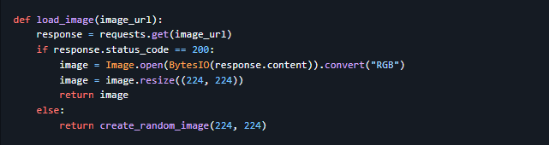
Image Loading
The model expects images to be of size 224x224, so we load the image from the URL and resize it

Slide 12
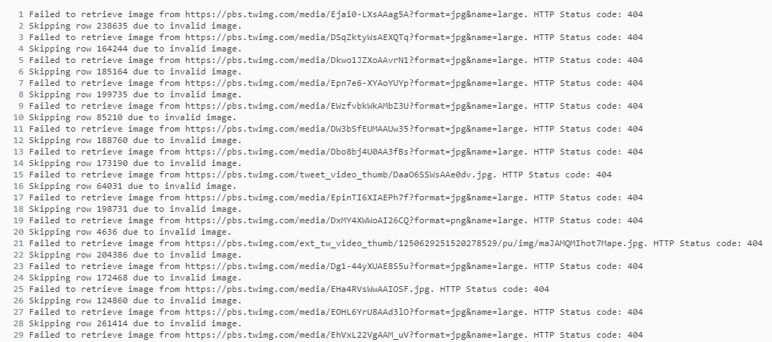
In my testing experienxce I found out that many URLs are not responsive and break the training loop. To counter this challenge I opted to create a random image of the same size to be given to the model other than simply a black image.

Slide 13
The model outputs image embeddings, text embeddings and logits.
For a batch of 16 images and 16 text descriptions, the output shapes would be:
Image embeddings: [16, 512]
Text embeddings: [16, 512]
logits_per_image: [16, 16]
logits_per_text: [16, 16]
Firstly I used the logits to predict the no. of likes.
Taking logits_per_image (or logits_per_text) and squeezing it out and averaging over all values to get the predicted no. of likes.

Slide 14
But there are few problems with this approach:
Logits are primarily used to measure image-text matching (how well a given image matches a given text prompt).
They don’t inherently represent features like image quality, content popularity, or audience engagement, which are crucial for predicting likes.
Averaging logits per image may cause a loss of meaningful information.
So instead of logits we use embeddings to predict the no. of likes.

Slide 15

Extract the image and text embeddings from the CLIP model
Then we concatenate the two embeddings along the last dimension
The combined embeddings are passed through a regression head to predict the number of likes.

Slide 16
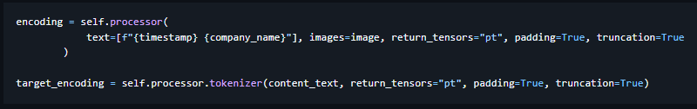

Task 2: Content Simulation
We want to generate the content of a tweet given the metadata. This task essentially requires understanding the relationship between the images and structured metadata.
We will use our pre-trained CLIP model to generate embeddings
1. Convert the timestamp and company name into embeddings
2.Extract the image embeddings from the CLIP model as usual.

Slide 17

3.The image, timestamp, and company embeddings are combined together and passed through
4. Cross Entropy Loss between generated content and target content is calculated to update the transformer

Slide 18
Hyperparameters can be adjusted to see changes in result:
- hidden_size = 512 (Size of the hidden layer)
- vocab_size = 49152 (Vocabulary size for text generation)
- num_heads = 8 (Number of attention heads)
- num_layers = 4 (Number of transformer layers)

Slide 19

THANK YOU
By Team Atreides
(Mohammed Arsh Raza)

